Slide 1





Home
Training Programme
News & Events
Threat Intelligence
About
CYBERSECURITY AWARENESS
& INCIDENT RESPONSE PORTAL
RESEARCH FINDINGS & DESIGN SUMMARY
Start Now
Team Members:
Sukoluhle Ndlovu
Oko Mwezo
Mpho Rakgobe
Ondela Citywayo
Kutlwano Kuape
WWW.CYBERSP.COM

Slide 2



Home
Training Programme
News & Events
Threat Intelligence
About
OBJECTIVE
Build a centralized portal for cybersecurity awareness & incident response.
Focus on employee education, real-time alerts, and efficient reporting.
Empower both technical & non-technical staff.

Slide 3



Home
Training Programme
News & Events
Threat Intelligence
About
TARGET AUDIENCE
General Staff requiring cybersecurity awareness
Corporate employees (non-technical & technical)
IT Teams & Security Officers

Slide 4

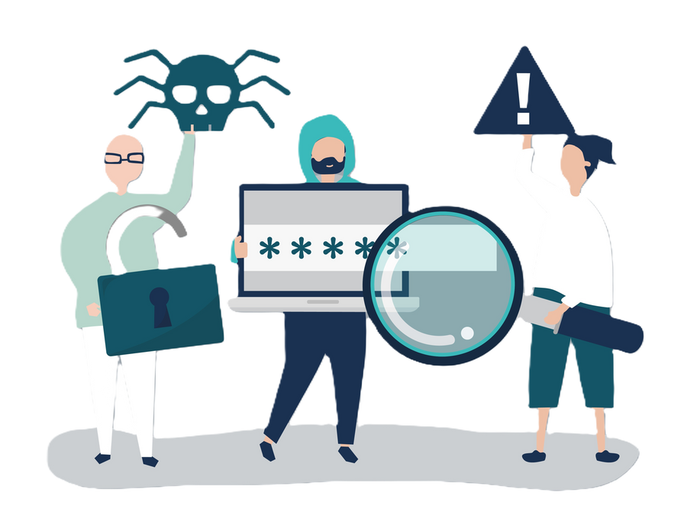


Home
Training Programme
News & Events
Threat Intelligence
About
KEY GOALS
Improve organizational cybersecurity posture via interactive learning
Provide automated guidance for phishing, malware, data breaches
Central hub for policies, training, and security updates
Enable quick, user-friendly incident reporting

Slide 5

Home
Training Programme
News & Events
Threat Intelligence
About
PORTAL STRUCTURE & FEATURES
Core Layout
Functional Sections
About – Purpose, benefits, and portal overview
Training Programme – Interactive courses, quizzes, certification badges
Threat Intelligence – Real-time alerts, phishing/malware dashboards
Incident Report – Guided reporting form + severity categorization
News & Events – Cyber updates, workshops, webinars
Policies & Resources – Downloadable security guidelines & SOPs
Contact – IT & Security team support channels
AI Chatbot – 24/7 real-time threat response assistant
Header/Footer – Easy navigation, login/logout, alerts icon
Hero Section – Engaging intro with cybersecurity awareness banner

Slide 6


Home
Training Programme
News & Events
Threat Intelligence
About
Value & Impact
TOWARDS A SUSTAINABLE FUTURE
Increased awareness → Reduced human error & phishing success rates
Streamlined response → Faster incident handling & reporting
Empowered employees → More confident handling cyber threats
Centralized hub → Easy access to security knowledge & updates

Slide 7
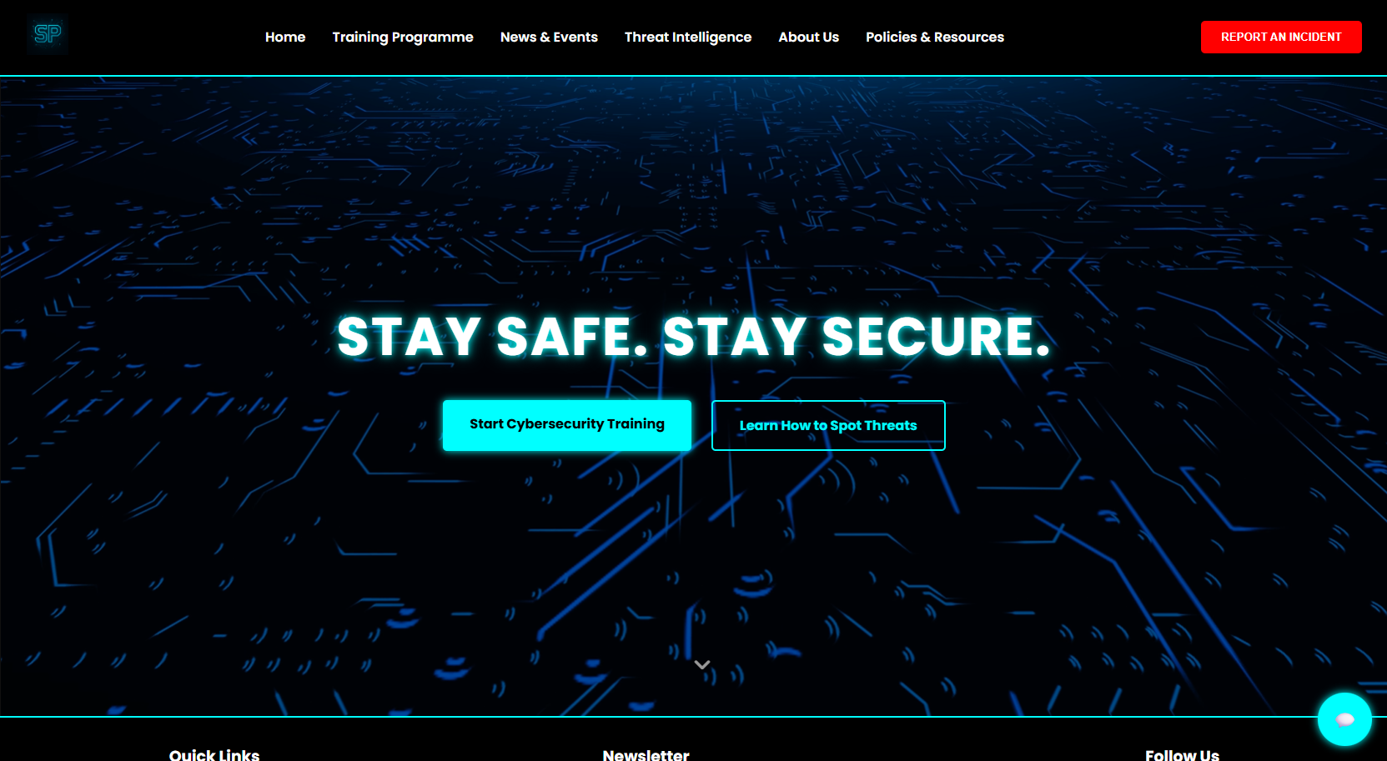
Home
Training Programme
News & Events
Threat Intelligence
About

Slide 8
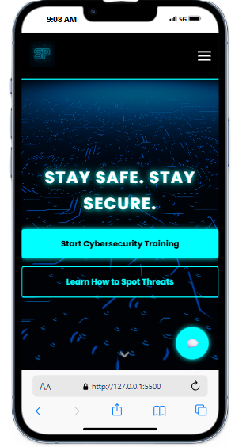
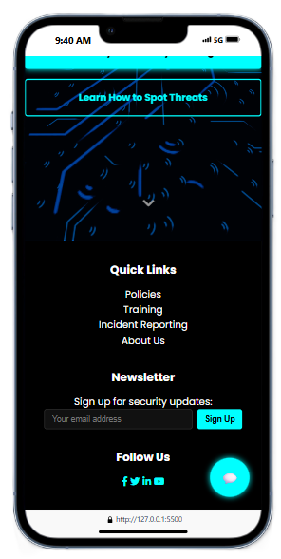
Home
Training Programme
News & Events
Threat Intelligence
About

Slide 9
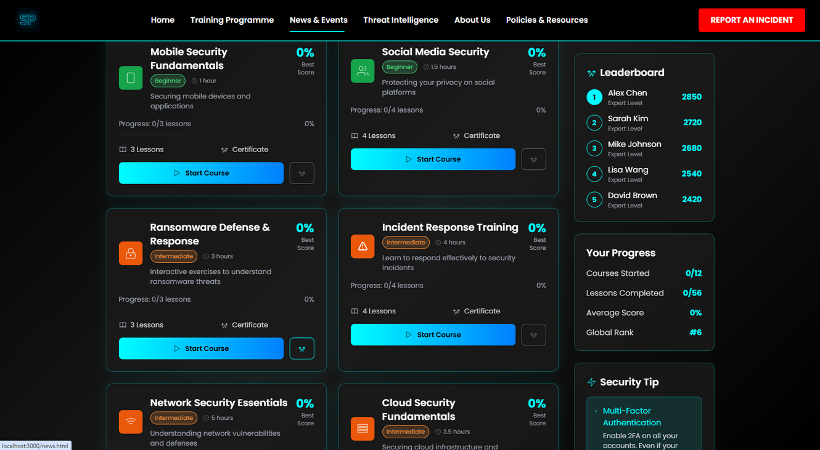
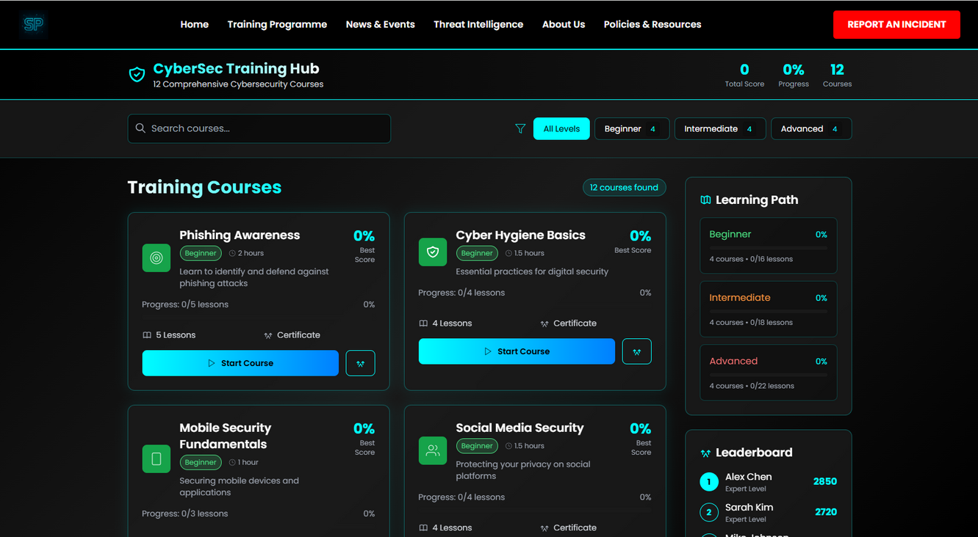
Home
Training Programme
News & Events
Threat Intelligence
About

Slide 10
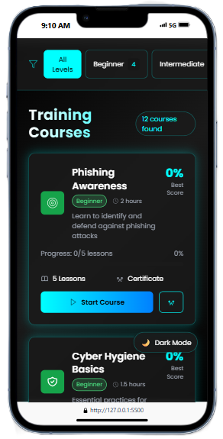
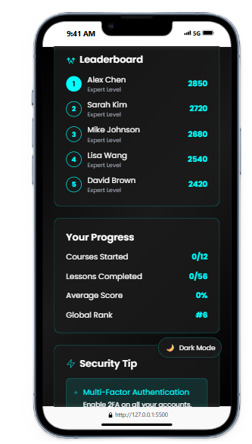
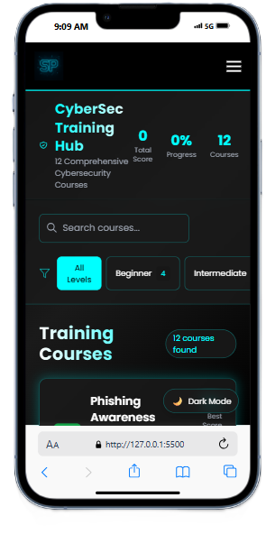
Home
Training Programme
News & Events
Threat Intelligence
About

Slide 11
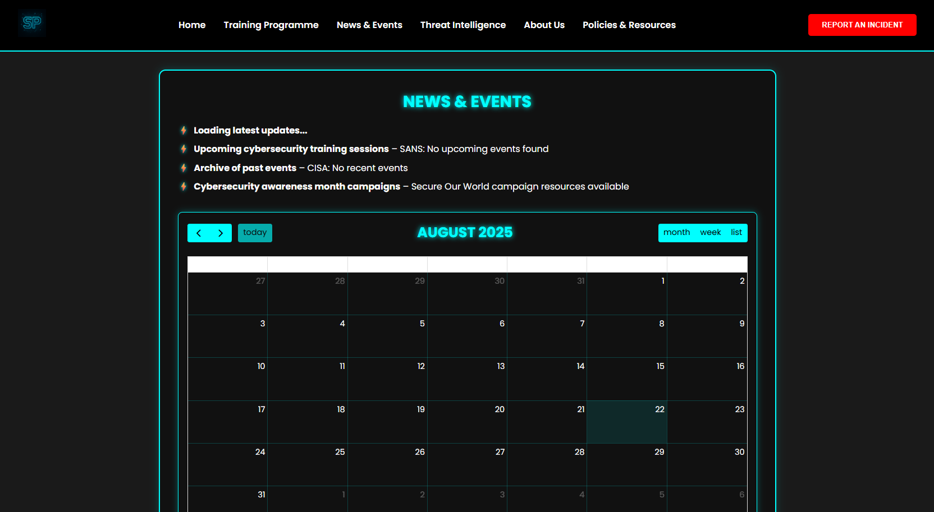
Home
Training Programme
News & Events
Threat Intelligence
About

Slide 12
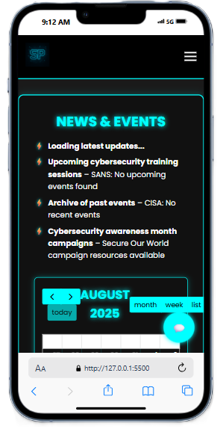
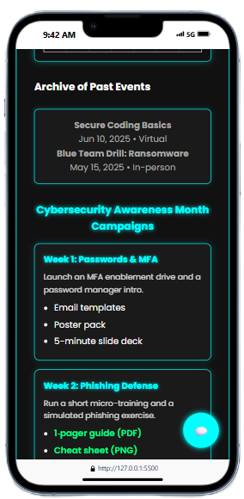
Home
Training Programme
News & Events
Threat Intelligence
About

Slide 13
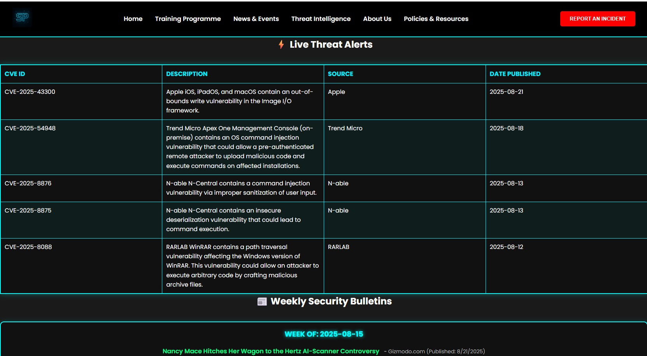
Home
Training Programme
News & Events
Threat Intelligence
About

Slide 14
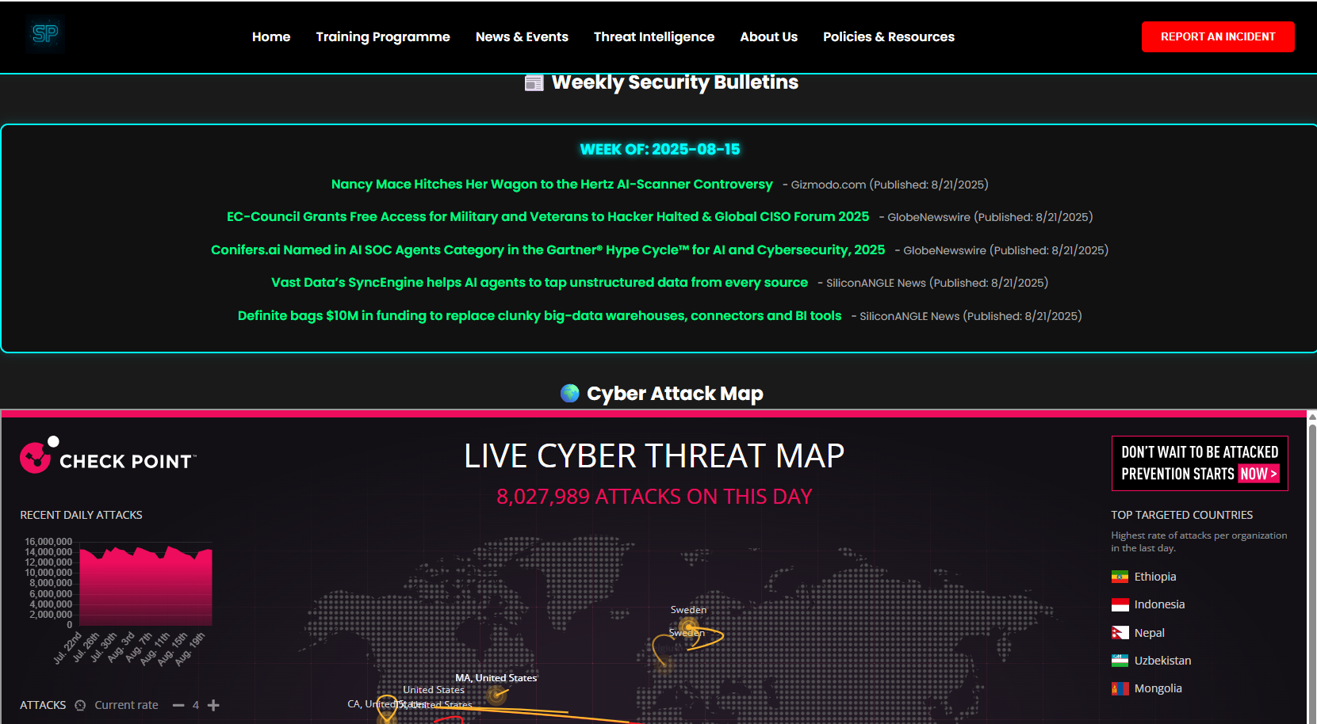
Home
Training Programme
News & Events
Threat Intelligence
About

Slide 15
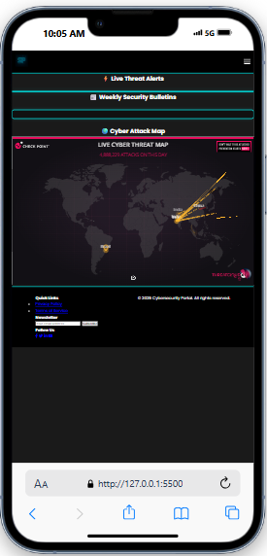
Home
Training Programme
News & Events
Threat Intelligence
About

Slide 16
Home
Training Programme
News & Events
Threat Intelligence
About
THANK YOU
STAY SECJRE. STAY ARLET. STAY CONNECTED
End Presentation
WWW.CYBERSP.COM

